Slide 1
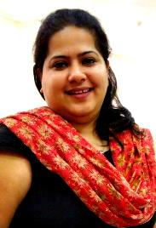
Urvi Thakkar
Nickname: Urvi
NU email: urvithakkar2019@u.northwestern.edu
Full-time or Part-time: Full-time
Years of Experience: 7
Industry: Electrical & Automation
Employer: Larsen & Toubro Group of Companies
Job Title: Assistant Manager & Executive Assistant to the GM
Undergraduate School: University of Mumbai
Undergraduate Major: Bachelors of Engineering
Short Biography: In the past 7 years Urvi’s had the opportunity to work in various departments, from Design to Marketing to Strategic Management at one of India’s premier listed engineering companies . Urvi credits herself with an MBA in General Management from Symbiosis Institute of Business Management, Pune, India with a desertion on “Time study as a quantitative tool”. In 2013, Urvi along with 4 others set up “Skillsphere Education”, an India based Soft Skill Development company which has now grown to a turnover of over $20M. In her free time, Urvi enjoys reading and is an avid debater and orator. Even today she continues to train the Indian contingent of students participating at various International Model United Nations (MUNs), particularly the ones participating at The Harvard MUN and The World MUN.

